Slide 1


PROPERTY SERVICES
Presented By: 22DCE079 MANAV PATEL
22DCE109 DHRUVAL SHAH 22DCE114 SHREY SHAH
Guided By : Prof. Binal mam

Slide 2
CONTENTS
Aim
Background Theory
Used Hardware
How website work
Scope
Glimpse of Website
Future Enhancement
Conclusion
References

Slide 3


01
Aim

Slide 4


Aim
Property Management concerns to Find A Perfect Home to Live With Your Family .

Slide 5


02
Background Theory

Slide 6


Background Theory
HTML
CSS
Software : VS Code

Slide 7


03
Used Hardware

Slide 8
Used Hardware
The selection of hardware is very important in the existence and proper working of any software. When selecting hardware, the size and requirements are also important.
Hard Disk Drive
Ryzen 7
8.0 GB RAM
512 GB Storage

Slide 9


04
How website works

Slide 10


Currently a user can see the photos and the details of the property and Agent and its Contact Detail. This site can also have log in , Registraction and other functionality.

Slide 11


05
Scope

Slide 12
Scope
The scope of real estate management and marketing encompasses various aspects of the real estate industry, including property management, marketing and sales of residential and commercial properties, real estate investment, and development.

Slide 13


06
Glimpse of Website

Slide 14
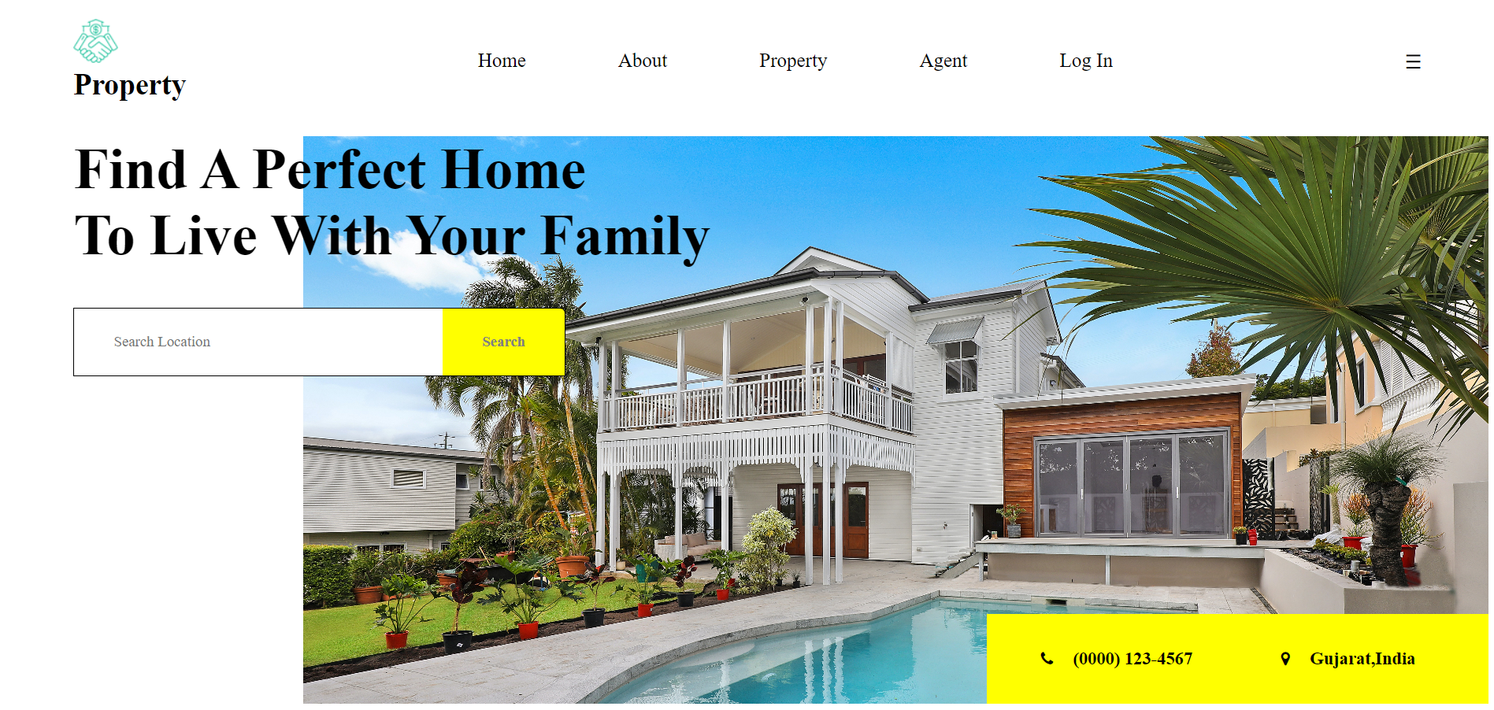

Slide 15


Slide 16
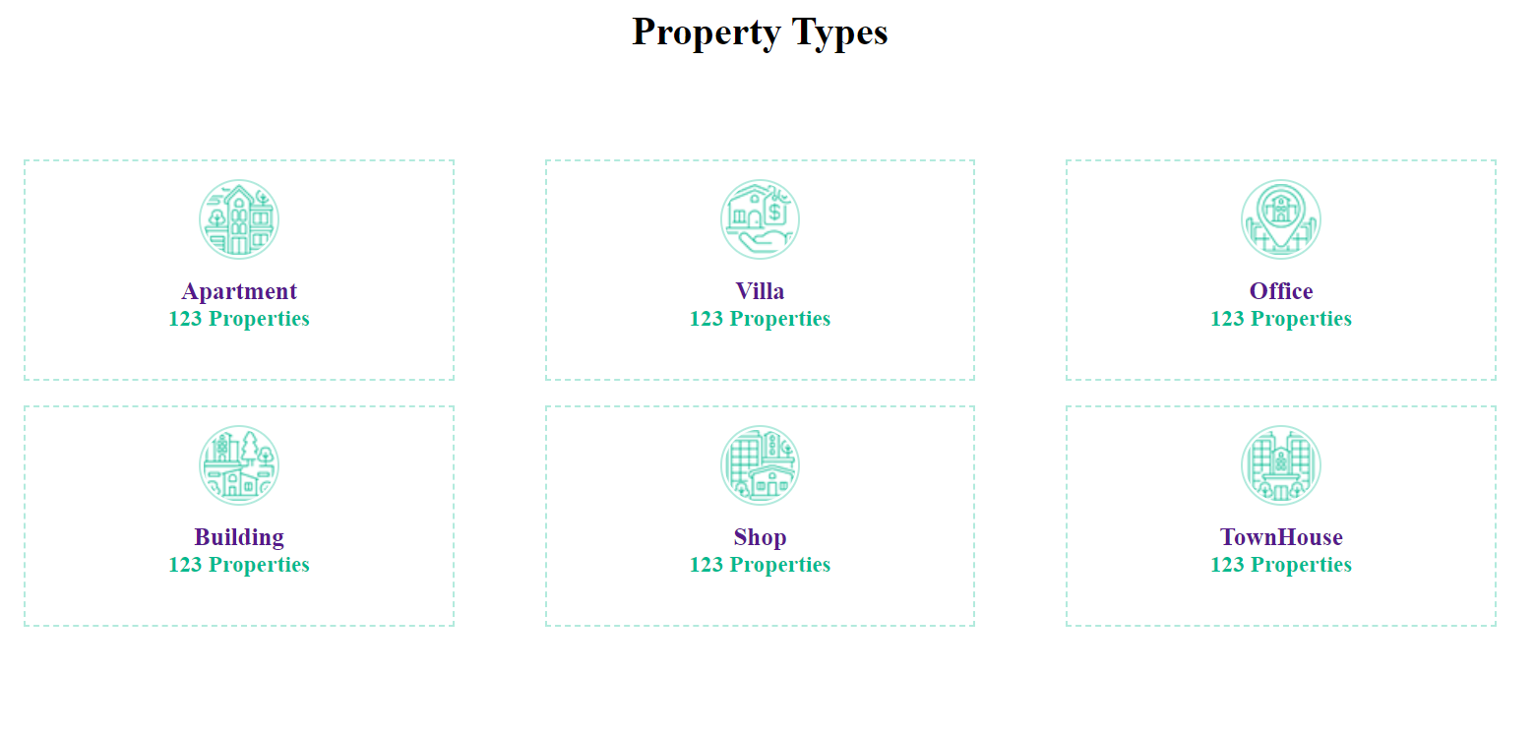

Slide 17
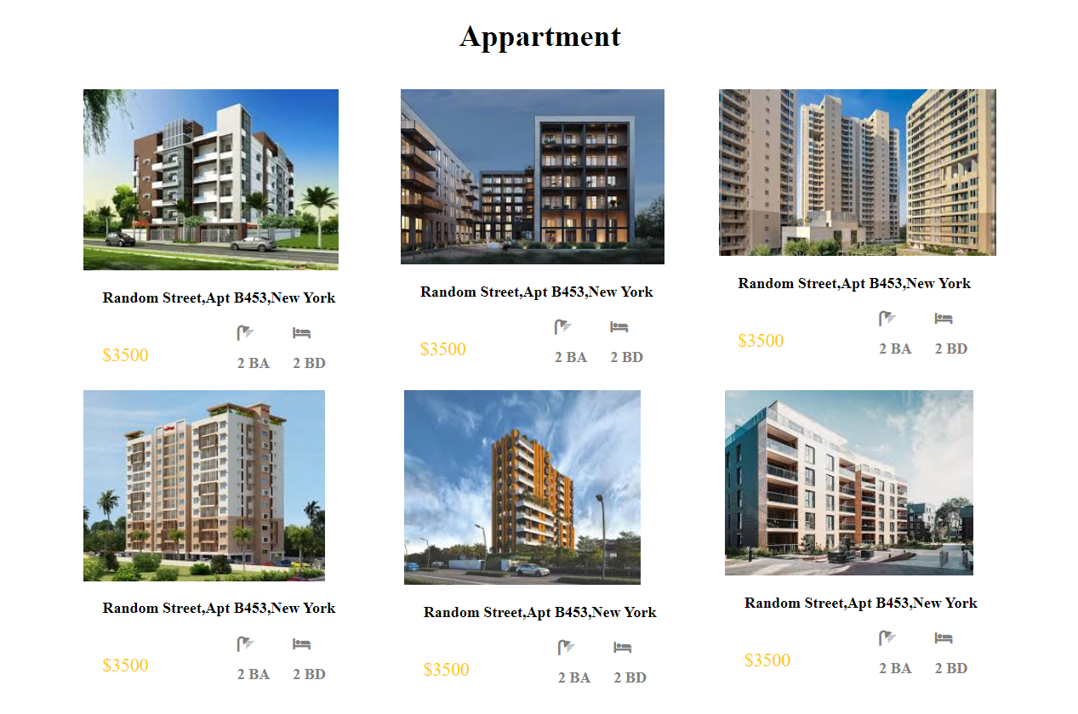
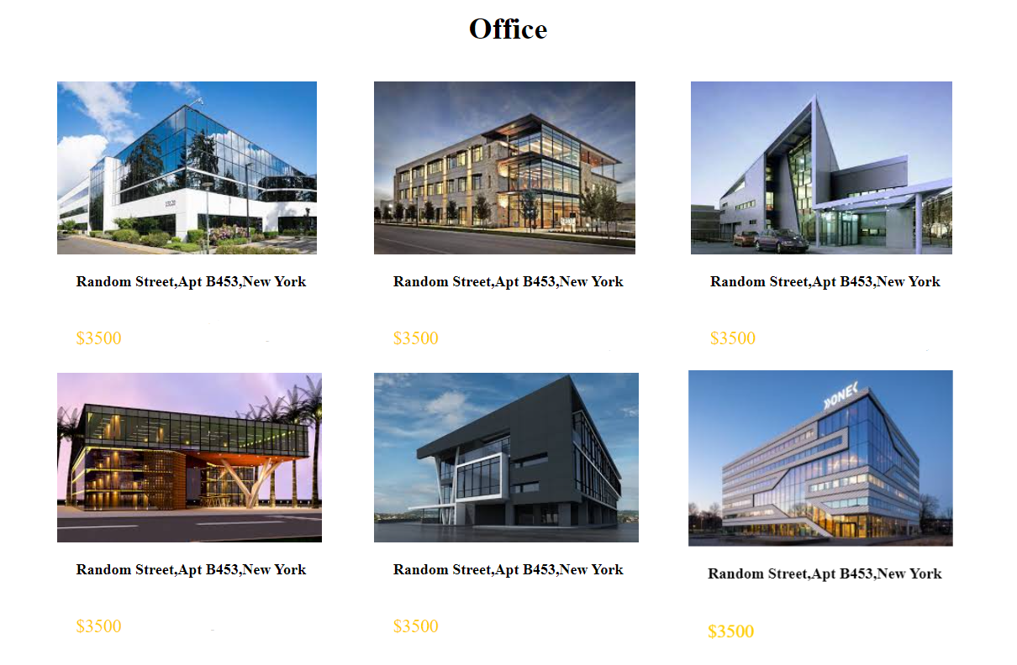

Slide 18
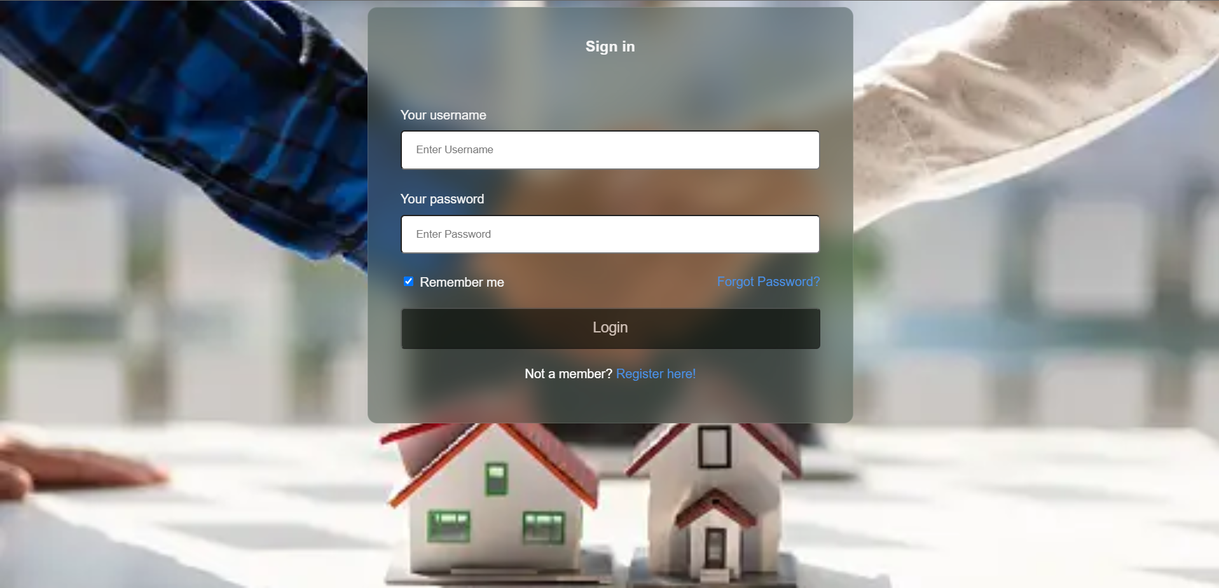
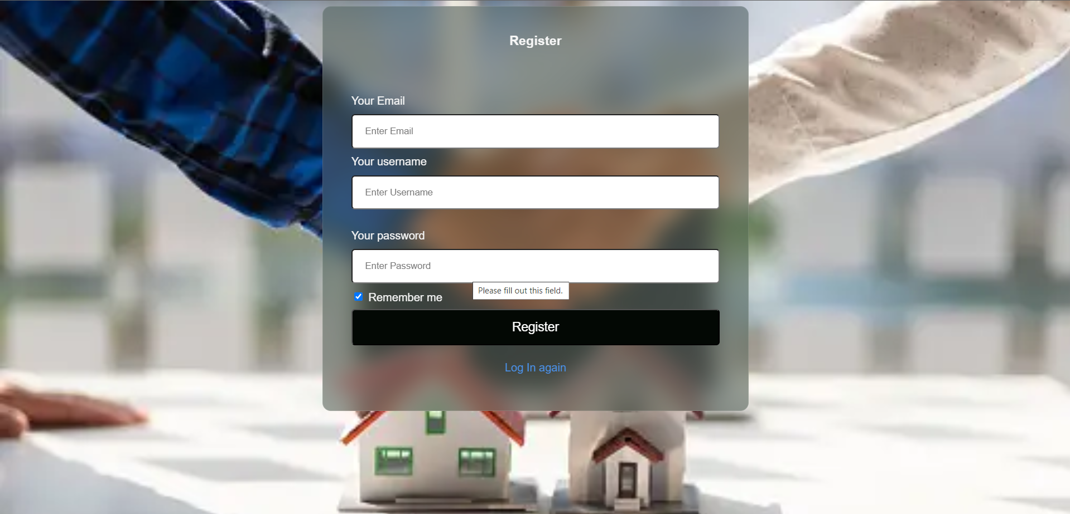

Slide 19

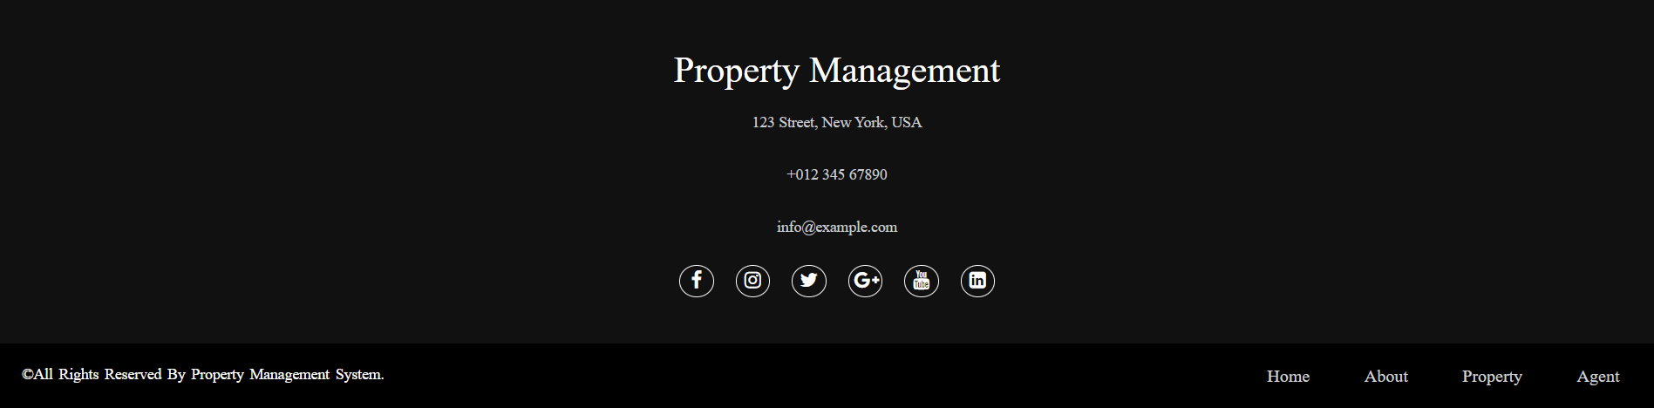

Slide 20
07
FUTURE Enhancement

Slide 21
Future Enhancement
Add Backend Database Support
Making Website More Responsive
Making Website More Attractive
Give User More features in Property Dealing

Slide 22
08
Conclusion

Slide 23
Conclusion
We have successfully implement the “Property Services” website with the help of various links and tools. Finally we hope that this will go a long way in Future.

Slide 24

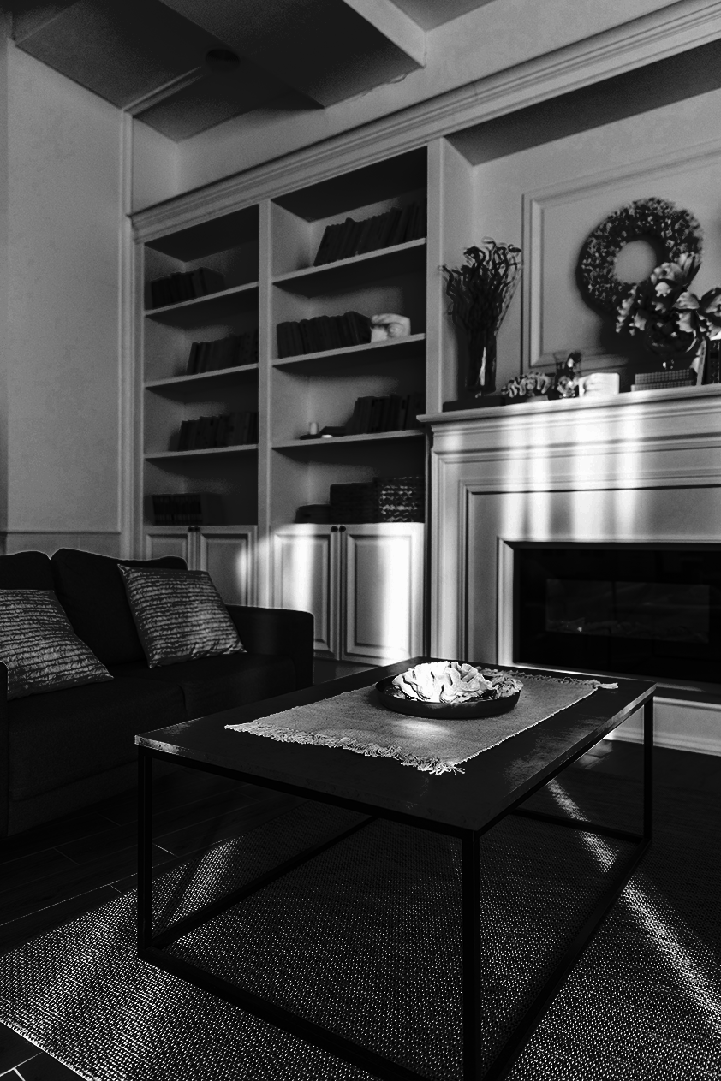
References
https://youtu.be/78-Vstbn3Qc?si=hZ64_9b9xQ86KOCS
https://fontawesome.com/icons
https://www.youtube.com/@CodeWithHarry
https://htmlcodex.com/demo/?item=2259

Slide 25
Thank you!

